Slide 1
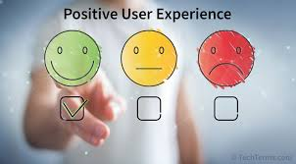
Exploring User Experience
Facilitated by: Jeffrey Basoah and Titus Kariuki

Slide 2
Agenda
Introductions
Why Higher Education
What is UX?
Agenda Item 3
Agenda Item 4
Activity
Q&A
Closing

Slide 3
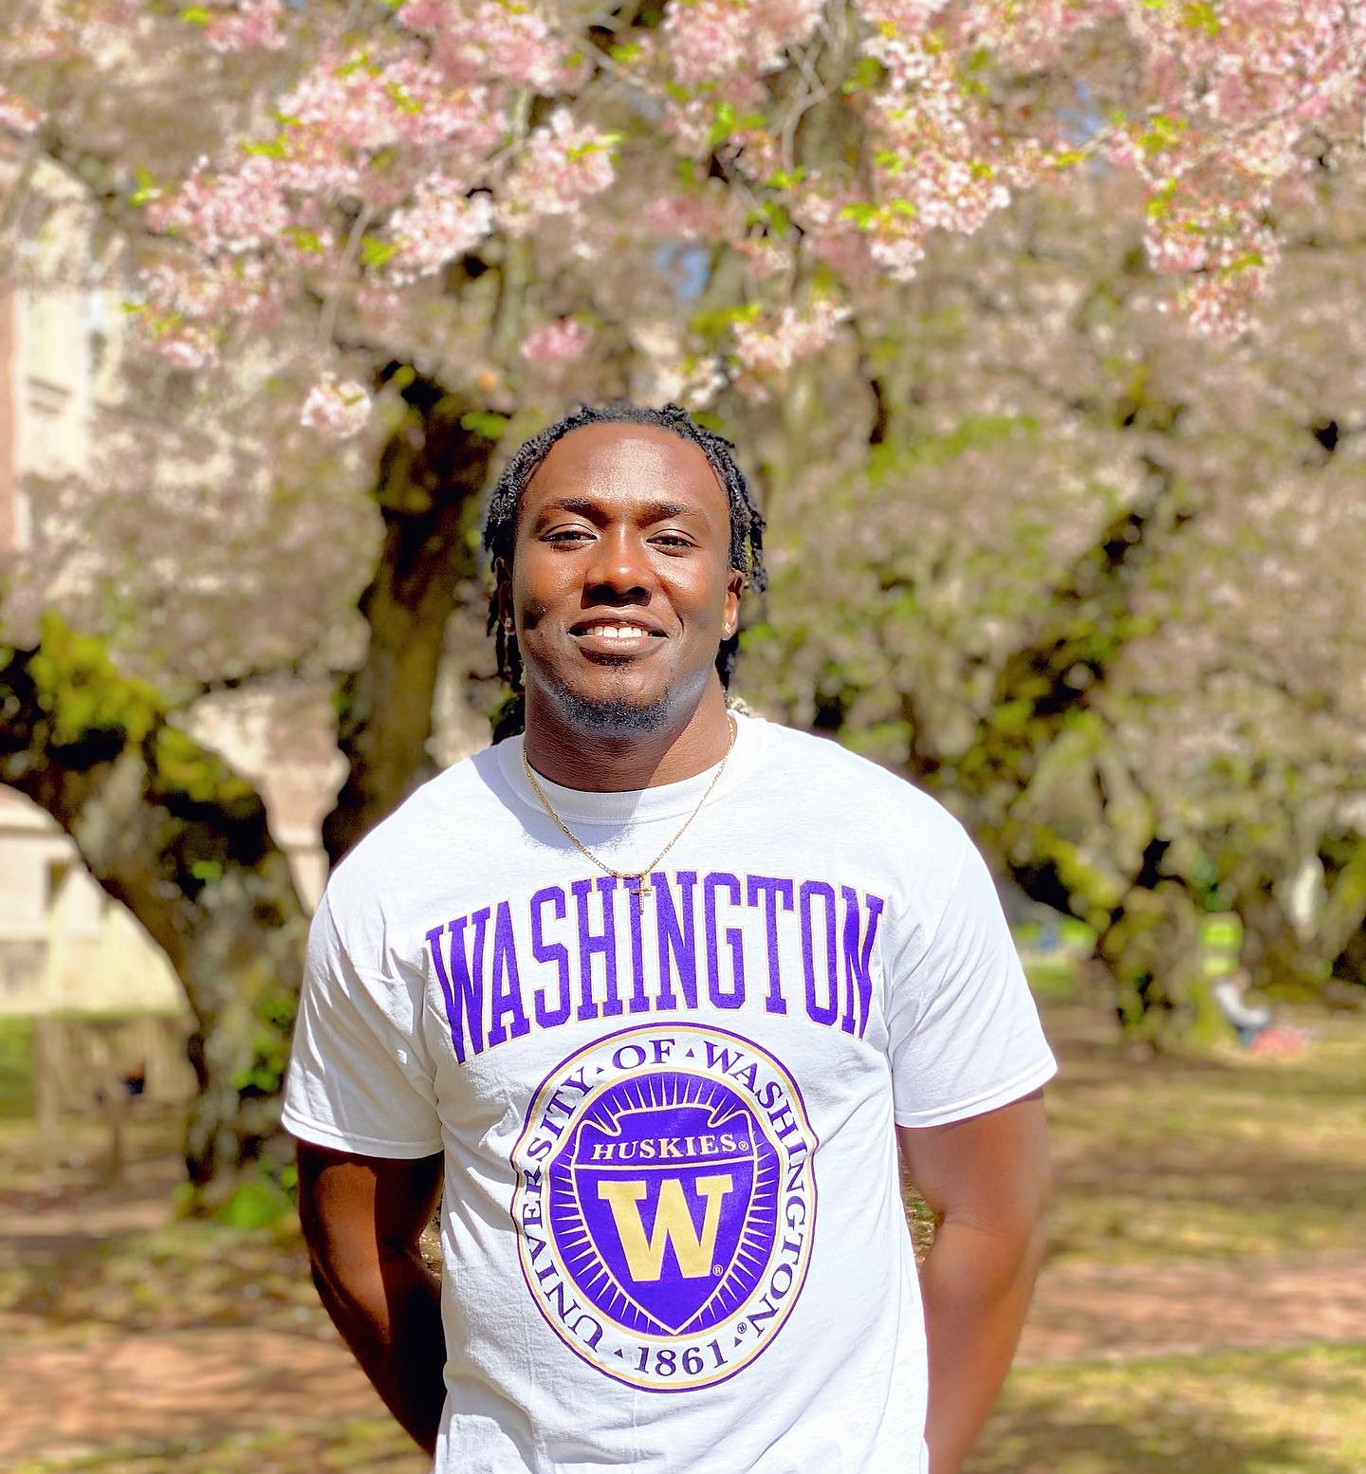


Jeffrey Basoah
he/him | 1st Year PhD | Human Centered Design and Engineering
Ghanaian, born and raised in Virginia
Bachelor’s in Mechanical Engineering @ Virginia Tech
Master’s in Industrial Systems Engineering @ University of Virginia
Director of Education for my non-profit, Acquiring Knowledge for Transcendence
Design Team Lead for AVELA
I love to play basketball, play chess, read, travel, work out

Slide 4
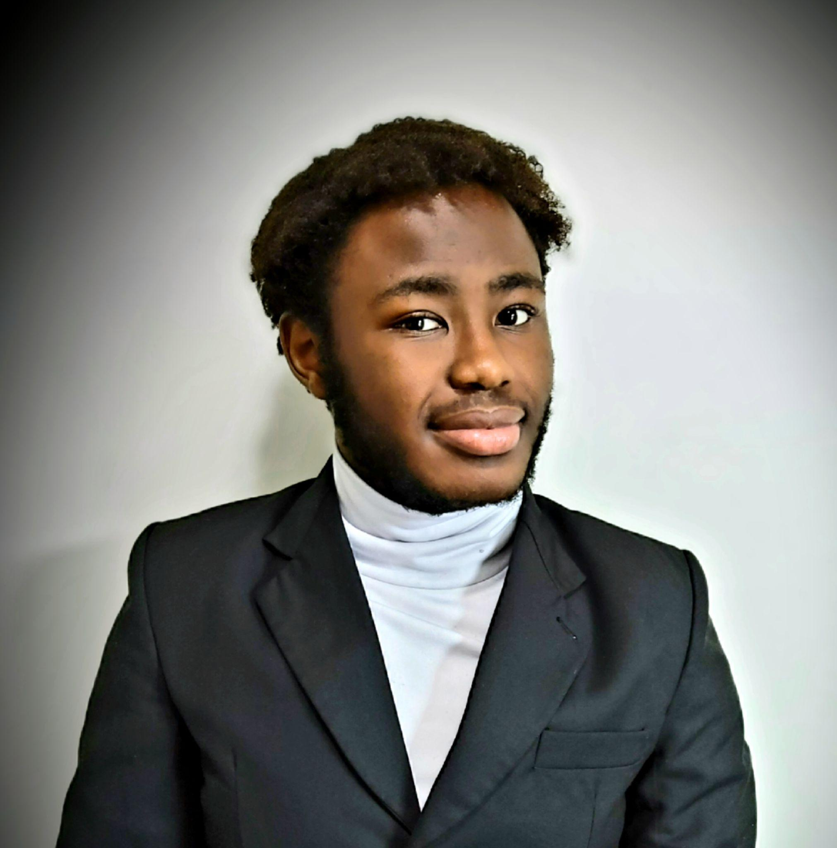
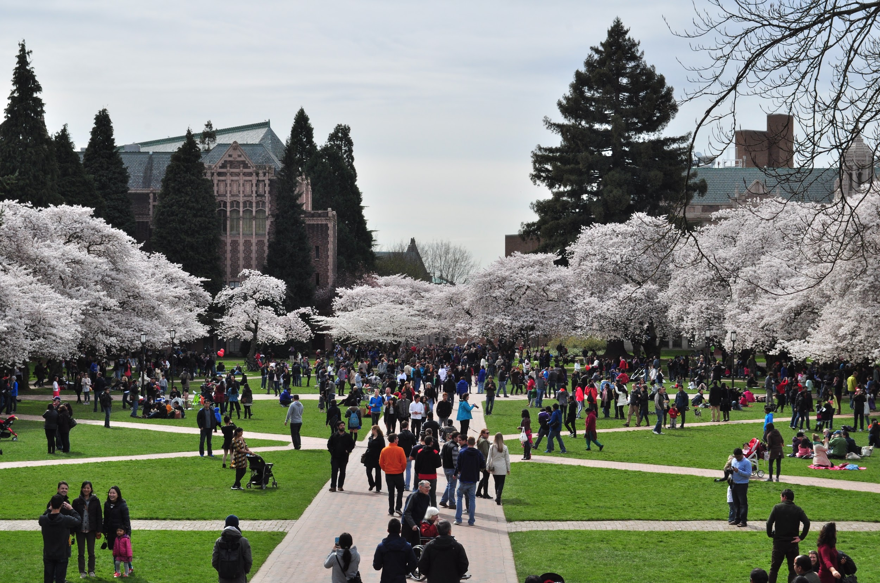
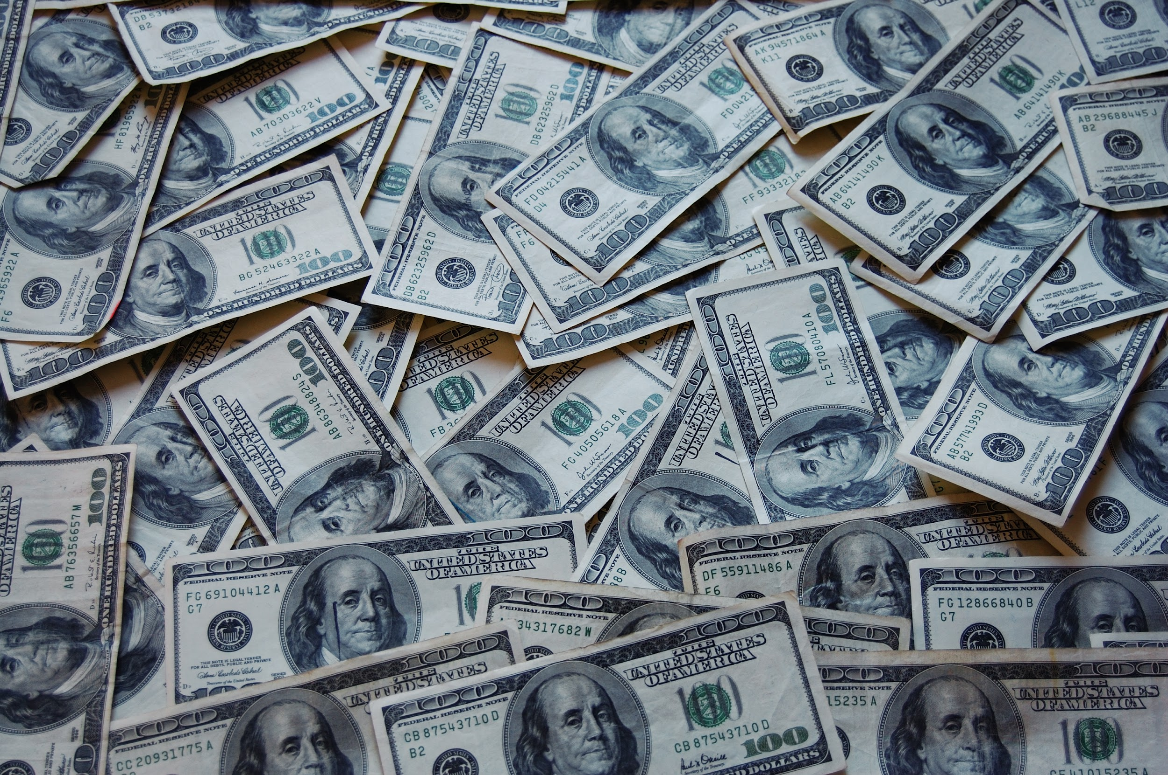

Who is Titus?
Just graduated from UW
Majored in Mathematics (UW) & Computer Science (from Highline College)
Incoming Business Analyst @ the Bank of New York (BNY) Mellon
The GOAT of NSBE - National Society of Black Engineers
Member of A Vision for Electronic Literacy & Access (AVELA)
Natively Kenyan
Interests: Tech, Finance, Wealth & Investing, Personal Development

Slide 5

Introduce yourselves!
Name
Grade
Why you signed up for this class
If you could have a superpower, what would it be and why

Slide 6

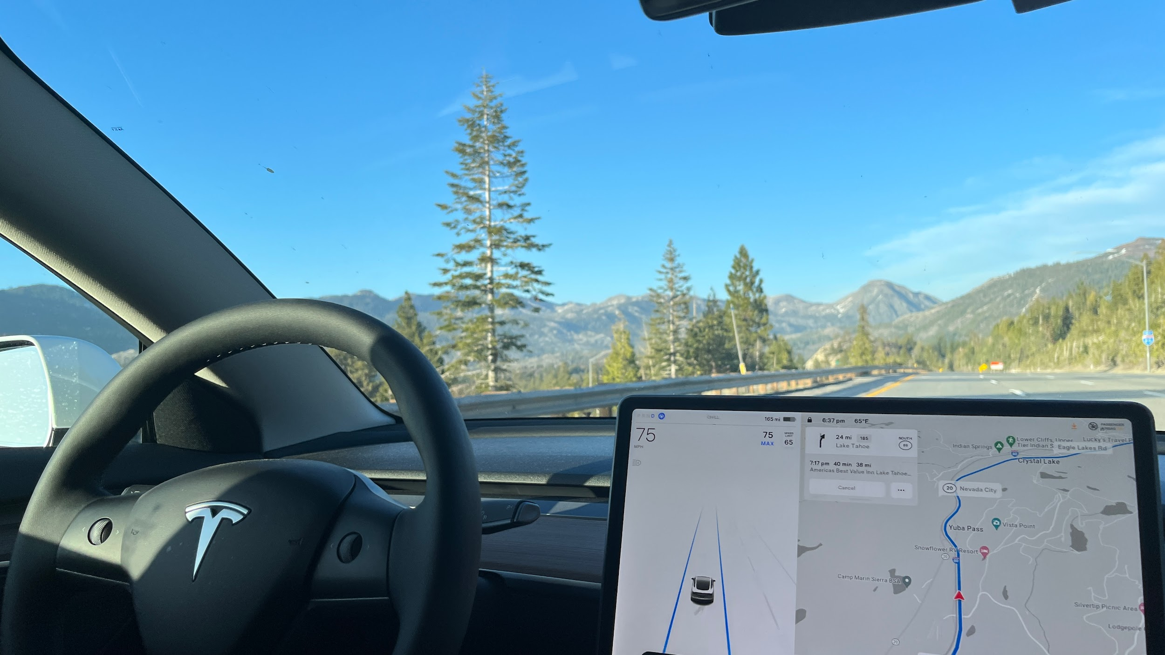
Why did I go to college?
Was good in all my subjects but my favorite was math
Dad used to work at Home Depot and would bring home wood toys for me to build
Told my mom I would build her a self driving car

Slide 7
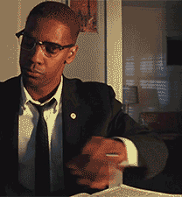
What made college difficult?
First time in my life in which I fully controlled all my decisions, didn’t always make the best ones
Got my first C during my sophomore year, got my first F during my junior year
Stayed for a 5th year, saw all my friends graduate without me

Slide 8
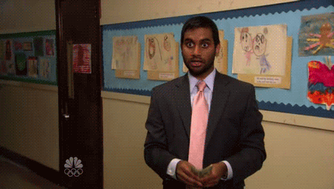
What made college worthwhile?
Financial freedom
Stability
I get to do what I want, when I want how I want to
Able to give my time and resources to those who need it
Made lifelong friends

Slide 9
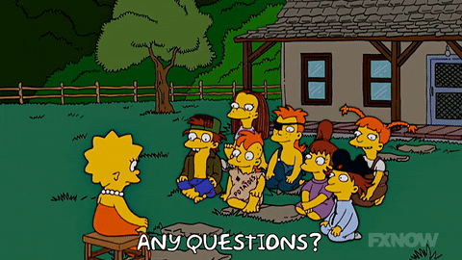
Questions for Us?

Slide 10


Before we get started,...
Thanks so much for being here today! To help us better support you and make sure you have a great experience, please fill out this quick survey before the fun begins.
And just a reminder, it’s anonymous!!

Slide 11

When I say “user experience”, what comes to mind?

Slide 12
User Experience is…
“the overall experience that a person has while interacting with a product or service, such as a website, app, or physical product.”

Slide 13

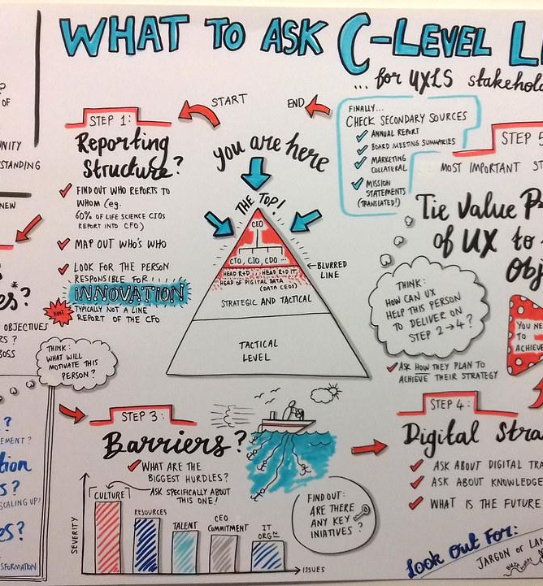

Potential Jobs/Career Paths
UX Writer - $70K to $110K
responsible for creating clear and concise copy for digital products that helps users understand how to use the product and achieve their goals
UX Designer - $80K to $120K
responsible for creating intuitive, user-friendly interfaces for digital products
UX Researcher - $90K to $130K
responsible for conducting research to understand user behavior and preferences in order to improve the design of products

Slide 14

Can you think of a time where you really enjoyed using an app, website, or product?
Notes:
A good user experience is one that is intuitive, easy to use, and satisfies the user's needs and expectations. It should be designed with the user's goals and preferences in mind, and should provide a seamless and enjoyable experience that leaves the user feeling satisfied and fulfilled. UX design is an important aspect of product development, as it can significantly impact the success of a product and the satisfaction of its users.

Slide 15




Great User Experience
Netflix
Google Maps
Airbnb
Spotify

Slide 16
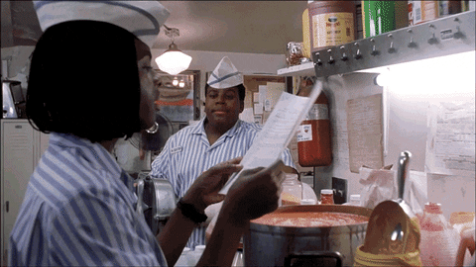
What is one thing you can say you learned today that you didn’t know before?

Slide 17
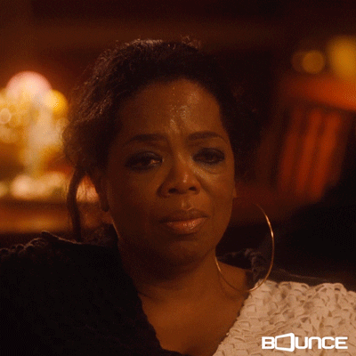
Can you think of a time where you really hated using an app, website, or product?

Slide 18



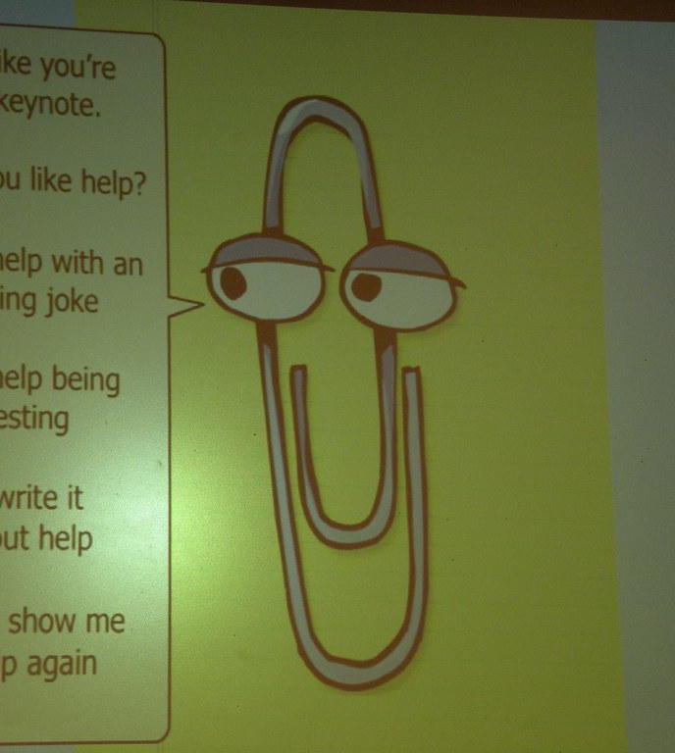
Bad user experience
Comcast
Yahoo Mail
Myspace
Clippy

Slide 19
Break time!

Slide 20
Questions?

